Slide 1
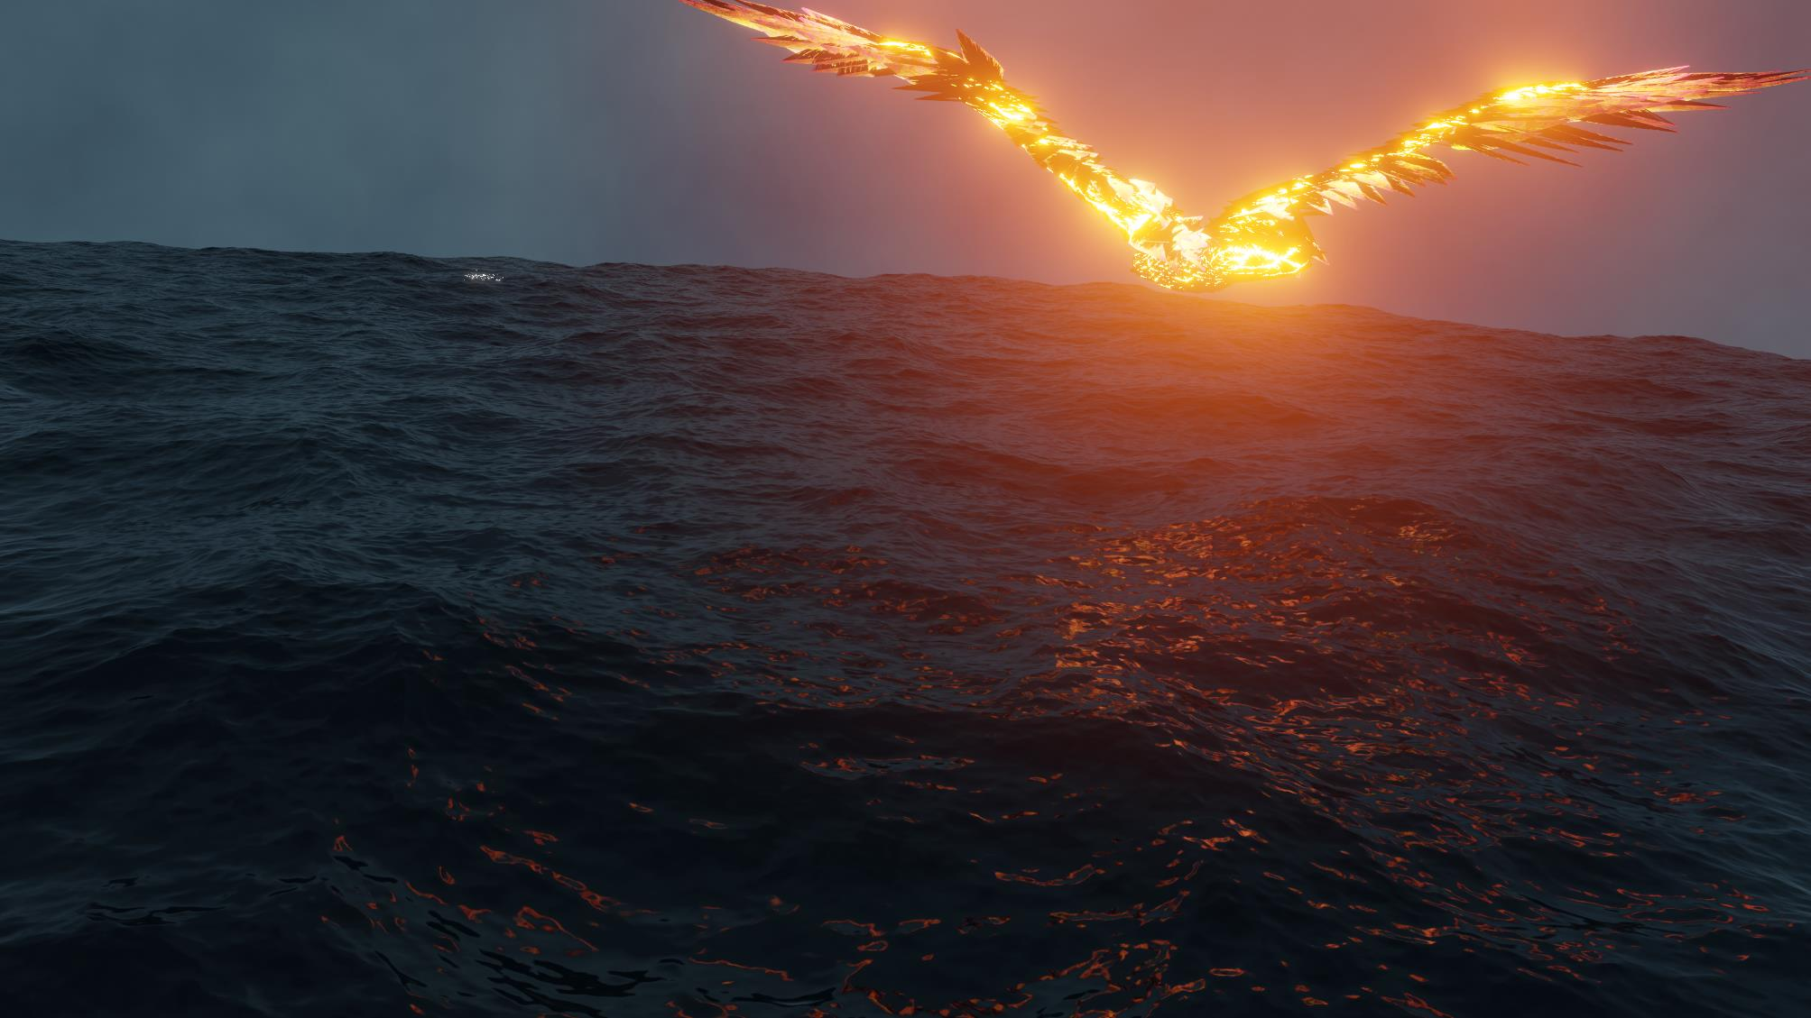
Millennium Award - Design Technology Digital Portfolio John Henry
All images in this presentation are created by John Henry

Slide 2
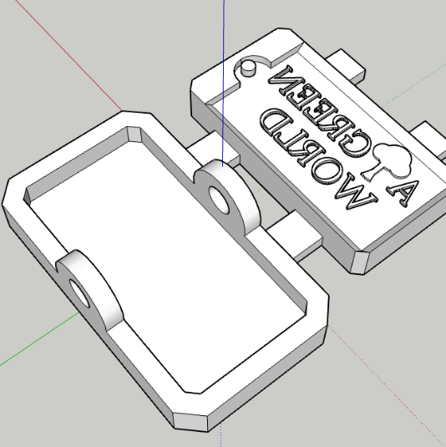
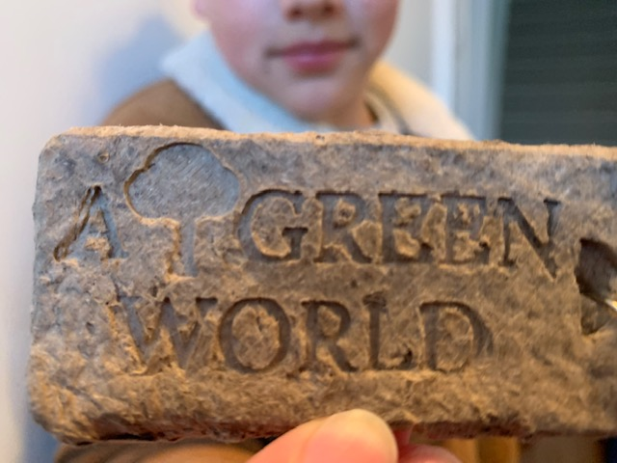
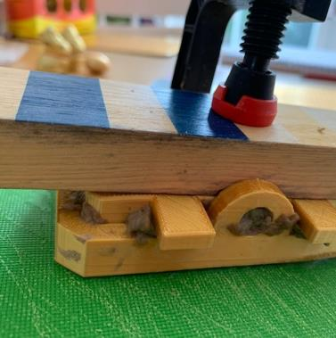
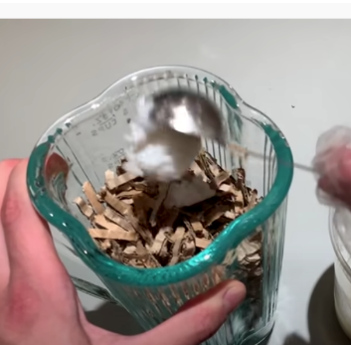
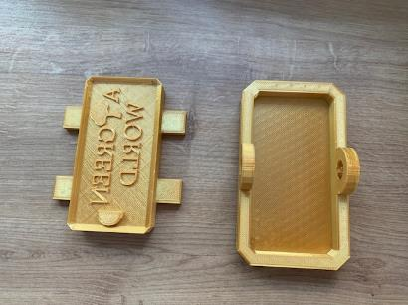
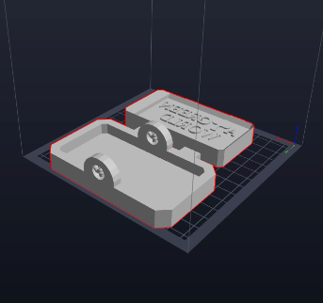
Eco-Moulding
A few months ago, I saw a video by XYZAidan in which he proposed a pulp formula which consists of cardboard, water and rice.
When pressure is applied to this substance, the water is removed, and the pulp takes the shape of any mould it is contained within.
I spent approximately 2 hours, using Computer Aided Design (CAD) to design a mould.
I then printed the mould in an eco-friendly plastic (PLA).
Next, I blended some old cardboard with the water and rice mix to make the pulp.
I then placed this pulp in my mould and clamped it for 24 hours.
When I removed the clamp, I had a moulded keyring.

Slide 3
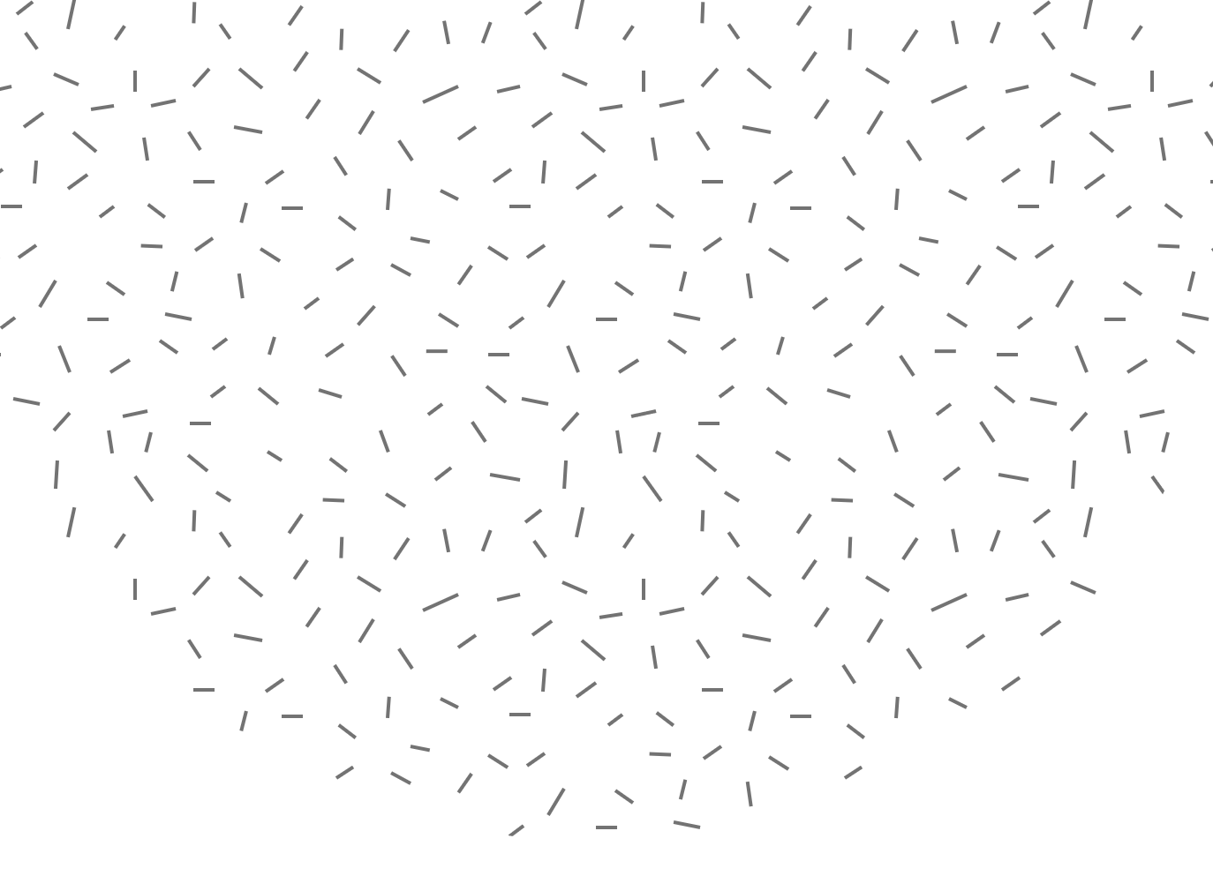
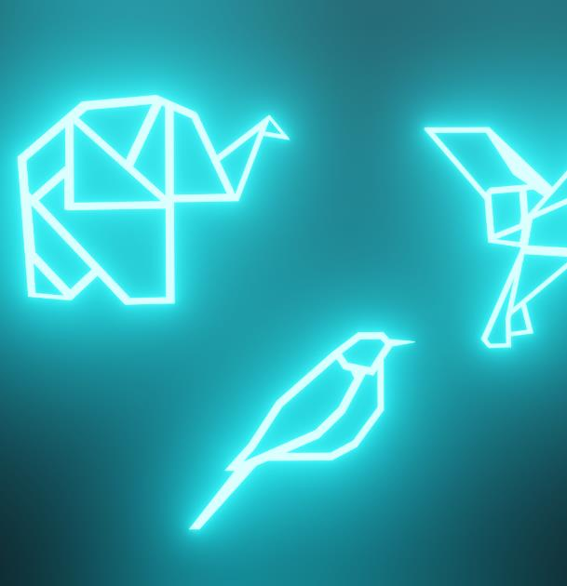
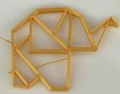

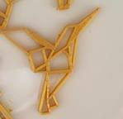
Keyrings
For a school entrepreneur project, my class was asked to start a business to raise money for charity.
My group and I decided to raise money for the Disasters Emergency Committee, a charity that helps those, suffering in Ukraine.
For this, I used the CAD program Sketchup to design a range of animal Keyrings, some of which are shown below.
I printed them and my group and I sold these to parents and visitors at the school fair. We raised £450.

Slide 4
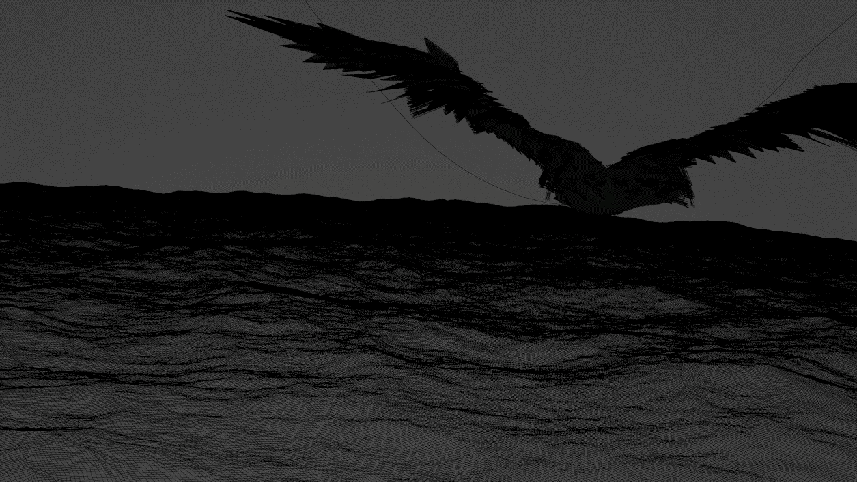
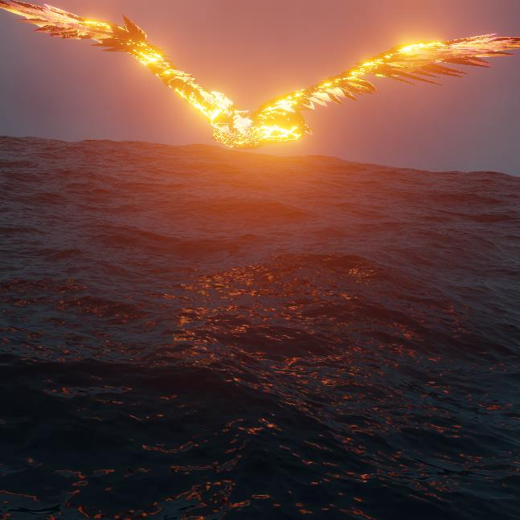
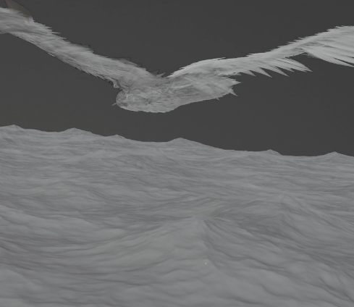
Polyfjord Challenge
In June, I entered a challenge, in which I had to create a short video, using the software, Blender.
I used a variety of techniques such as advanced texturing and procedural animation to complete the finished video which seamlessly loops.
On top of schoolwork, I spent approximately 10-14 hours per week for four weeks to achieve the final result.
As an extension to this project, I have also created a Visual Effects (VFX) breakdown in which I go through the steps of making it.

Slide 5
Please watch:
Polyfjord challenge initial render - https://vimeo.com/802077630/fbbcd603b2
Polyfjord challenge entry - https://vimeo.com/802077614/ee798c8a38
And Polyfjord challenge VFX Breakdown - https://vimeo.com/802077654/9f57f8568f

Slide 6
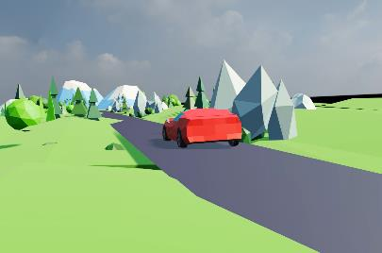
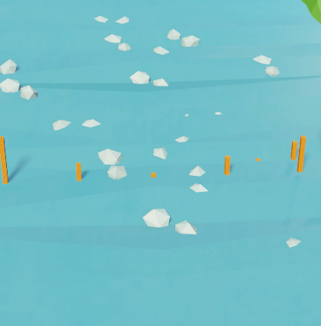
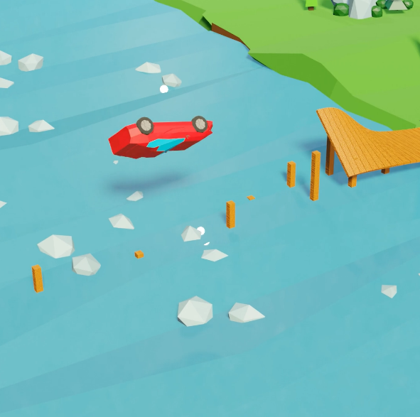

Low-Poly
Following on from this, I used low-Poly modelling and landscape building to make short videos, featuring a car.

Slide 7
Please watch:
Low poly car video - https://vimeo.com/802077559/b04e78fbeb

Slide 8
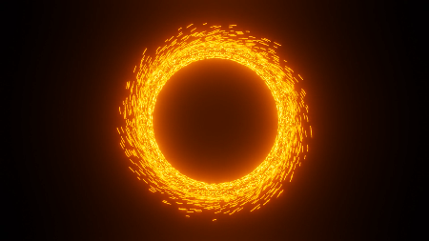
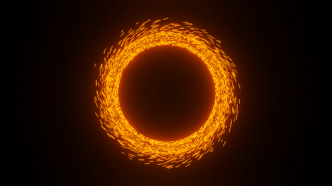
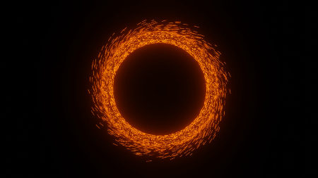
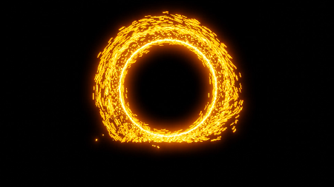
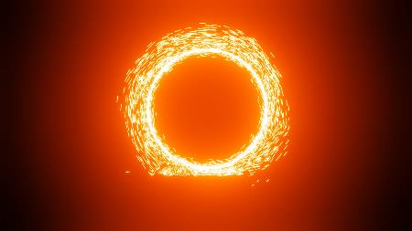
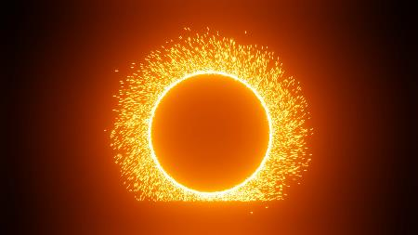
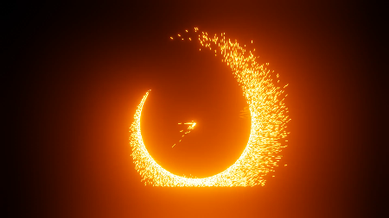
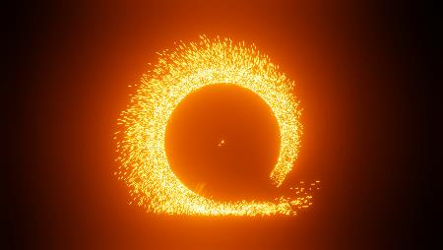
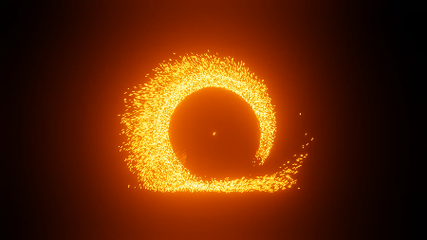
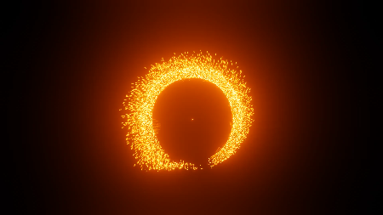
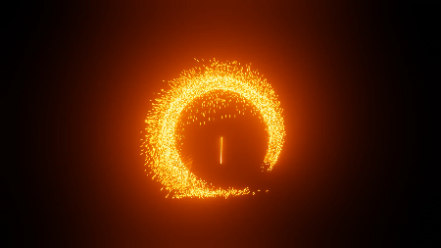
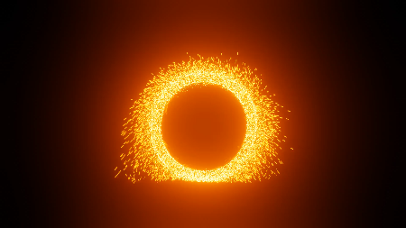
Portals
I have been attempting to replicate an effect from the film Doctor Strange in which a magical portal appears. Below, are the iterations and attempts to refine my effect:

Slide 9
Please watch:
Portal video - https://vimeo.com/802077672/aedfaa3a3d

Slide 10
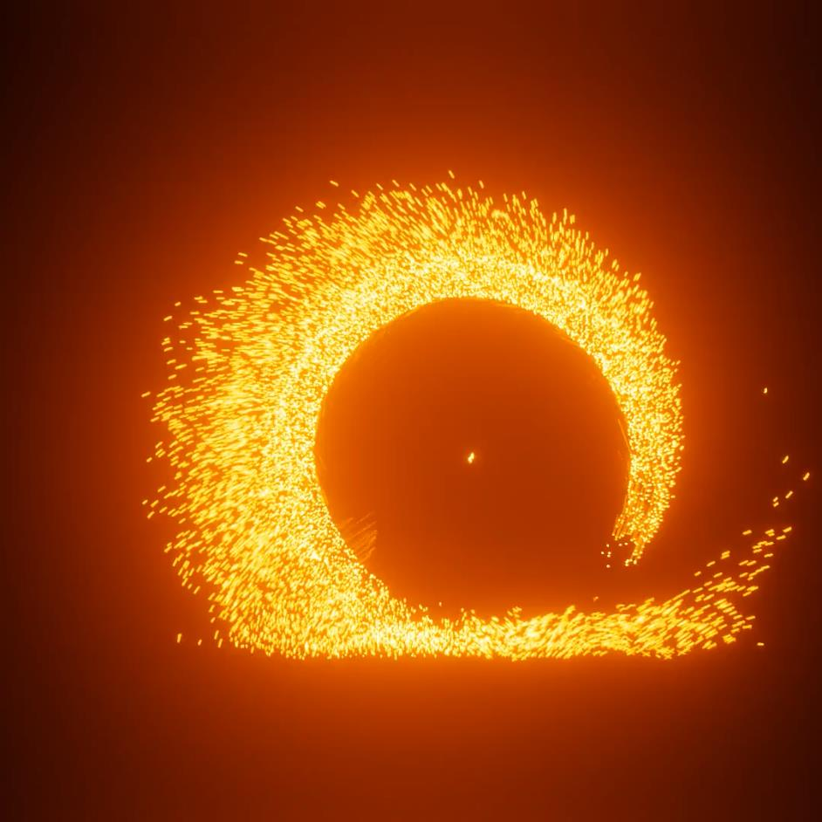
I have used this effect to make two short films.

Slide 11
Please watch:
Short portal video 1 - https://vimeo.com/802077701/16682cce07
Short portal video 2 - https://vimeo.com/802077735/4af5e2d8cf

Slide 12
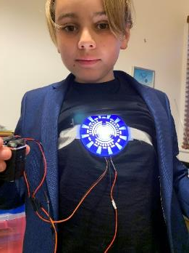
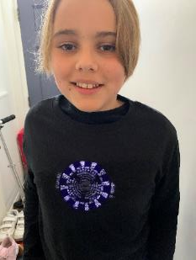
Sadly, because of lockdown, I have been unable to do much practical Design and Technology (DT). However, for Halloween during lockdown I made a replica from one of my favourite films: the arc reactor from Iron Man.
This project involved soldering, sewing and 3D printing.

Slide 13
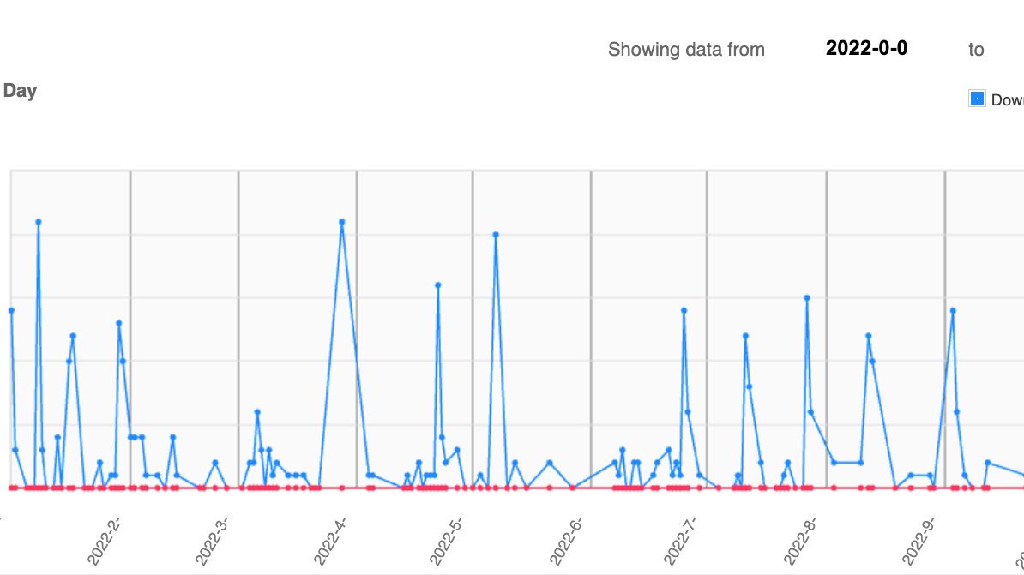
Thingiverse
I have an account on Thingiverse, the online platform for sharing 3D models:
My account name is JetPackSquirrel1ndustries.
Link to thingiverse.
I design files for printing using the software Sketchup and then upload them for others to use.
So far, over 2,600 people have downloaded my designs which include keyrings, cupholders and catapults.

Slide 14
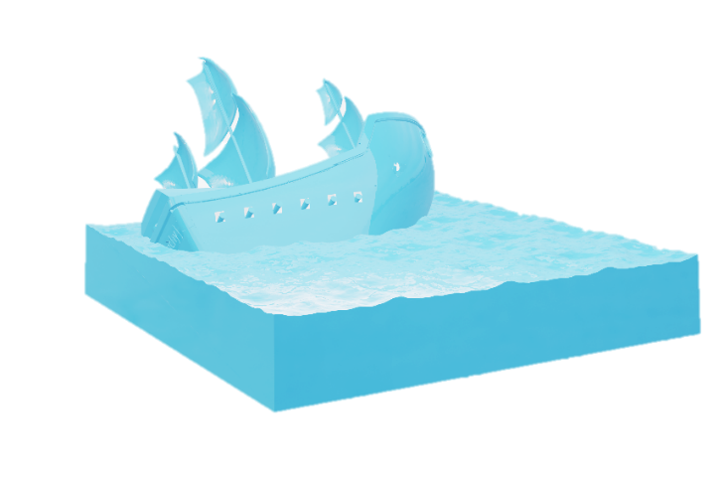
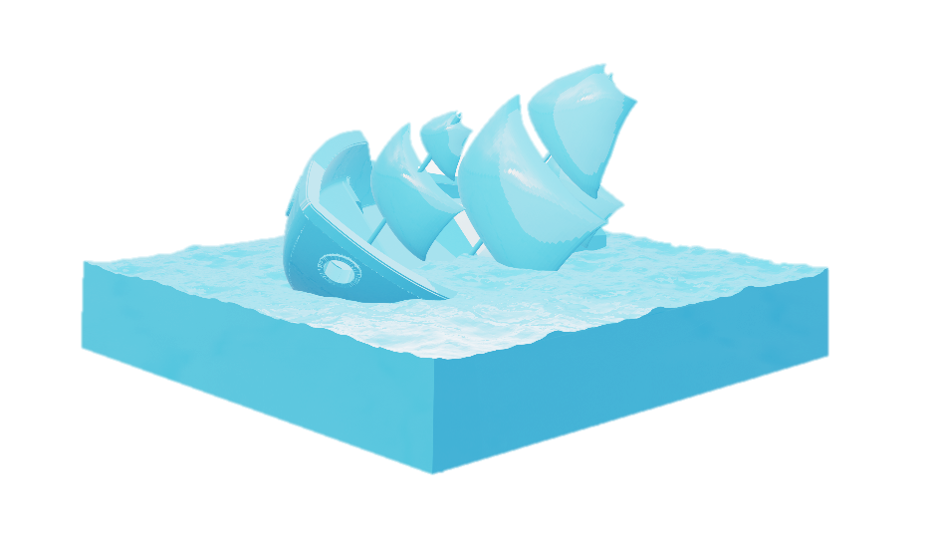
The Mary Rose
For a school history project, on The Mary Rose, I used Blender to create a model of the iconic ship, frozen in time, at the moment when it sank.
The model is inspired by the iconic 3D printed boat, Benchy.
This design incorporates many of the theories as to why it sank:
A large hole, in the side from a cannonball,
The tilting to one side, from a large gust of wind,
Open and submerged gunports,
A crew that was ignoring the battle and relaxing, below deck,
and unnecessarily tall masts, making the boat top heavy.

Slide 15
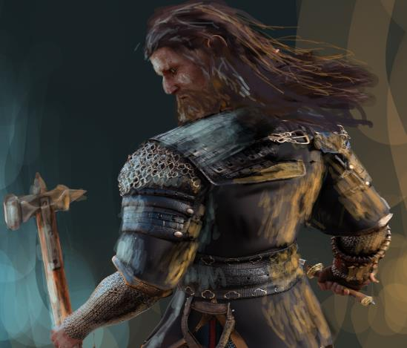
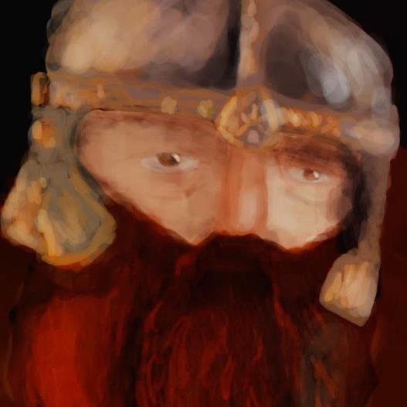
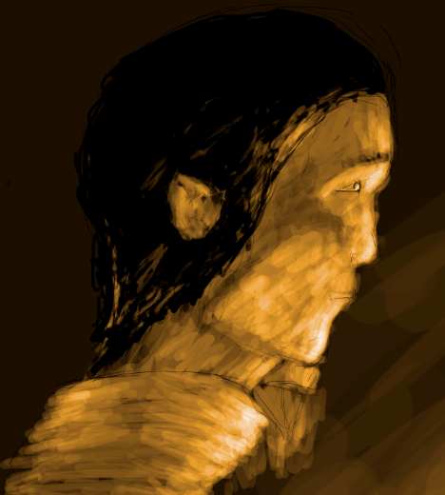
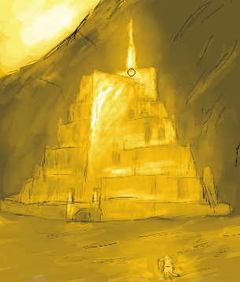
Concept Art
I have recently been inspired by the works of Alan lee on "The Lord Of The Rings"
His job was to design everything, from the swords of the orcs to the door of The Shire. He took into account, the practical nature of these as well as their aesthetic importance.
In my drawing of Fingolfin, I considered Tolkien's description of elves as graceful yet strong.
This influenced my drawing, giving him angular cheekbones yet a strong, muscular neck.
And when designing Gimli, I took inspiration from cinematic reference but also improved the bristle and sharpness of his beard.
I used a hard brush with high opacity to help me get the hardness and strength of the Dwarf.
I used the program "Krita" to produce these drawings.
Dwarven warrior
Gimli:
Minas Tirith:
Fingolfin:

Slide 16
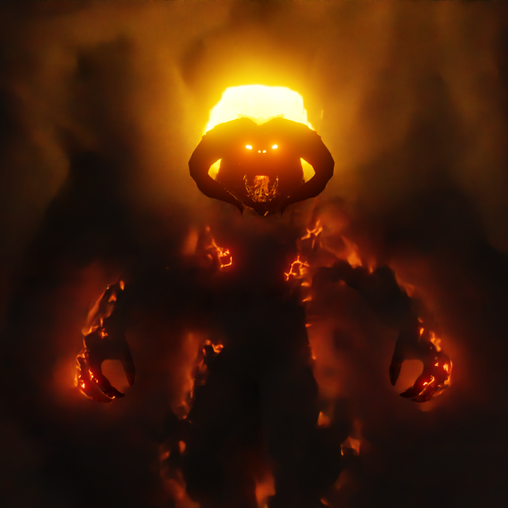
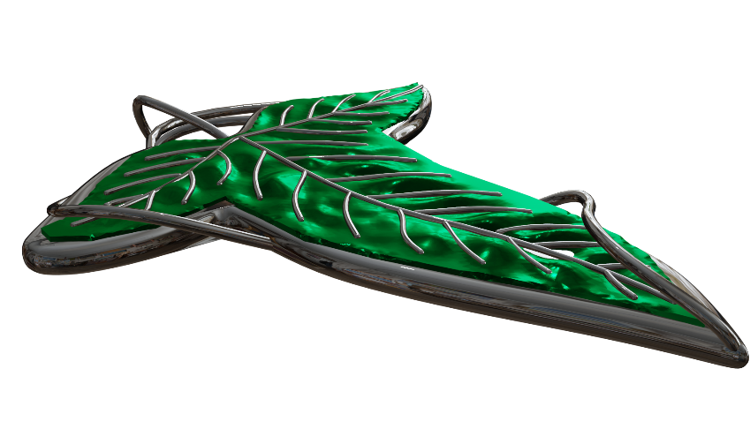
Current Projects
At the time of writing, I am working on two other projects.
Texturing, simulating, and rigging a balrog (fire monster from Lord Of The Rings),
Modelling a replica, for 3D printing, of an elven brooch, seen in The Lord Of The Rings.

Slide 17
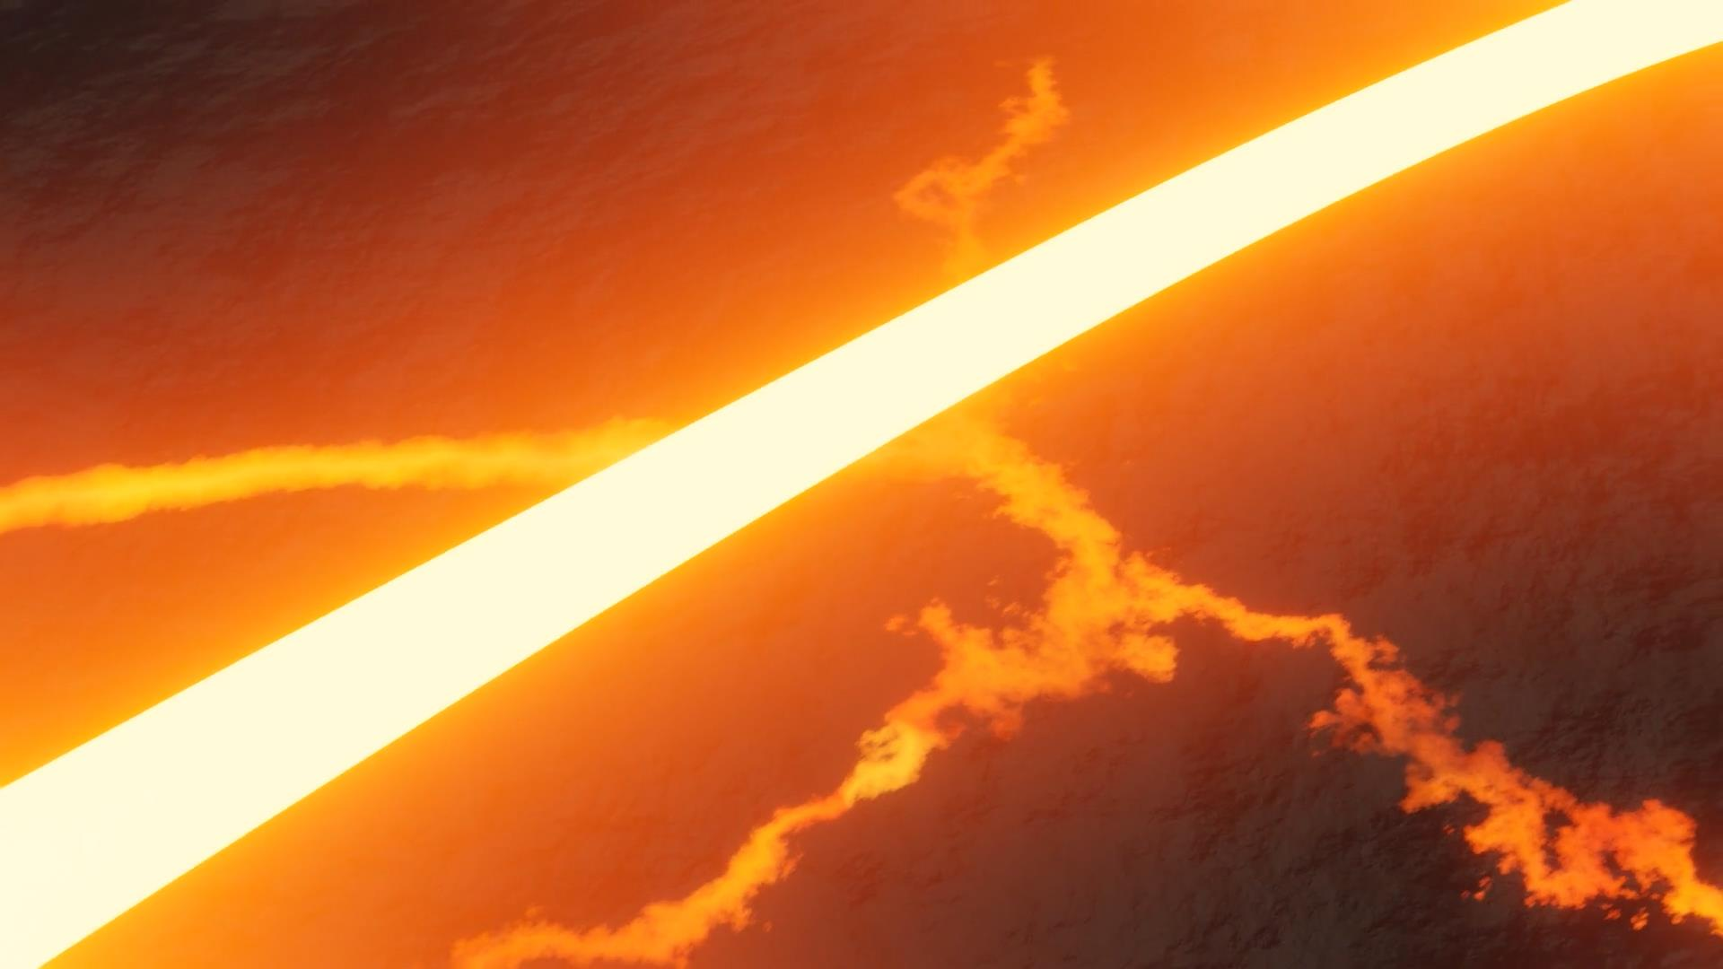
Made By Me:
I noticed that many creators choose to develop a signature credit to display after every video they produce.
When making my own, I used fluid simulation, complex texturing and animation to achieve the desired effect. I was inspired by the announcement for the Amazon series: "The Rings Of Power".
Please Watch: "Made by John Henry“ - https://vimeo.com/802077584/af06318d9c

